Slide 1
Object Oriented Data Structures
Queues
Implementations of Queues
Circular Implementation of Queues

Slide 2

Queues
Print Queues
Registration Lines
Movie Lines
Job Queues
Bank Lines
Plane Arrival and Departure
Stock Activity Report

Slide 3
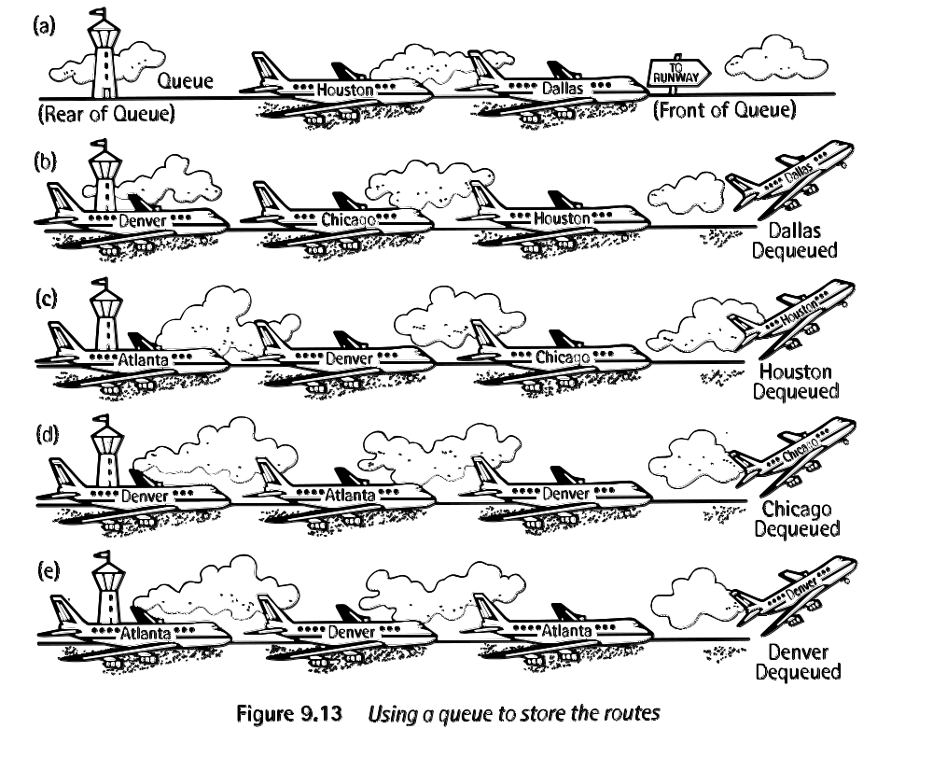
Real Life Queues

Slide 4
Basic Idea
A queue can hold an arbitrary number of elements, but you place new elements in at one end (back) and remove elements from the other (front) end.
Sometimes called a FIFO structure, for
First In, First Out.

Slide 5
ADT - Queue
Create the queue, leaving it empty
Test whether the queue is empty
Append a new entry onto the back of the queue, if possible
Serve (delete) the entry from the front of the queue, if not empty
Retrieve front element of queue, if not empty
A queue of elements of type T is a finite sequence of elements of T, together with the operations:

Slide 6
Partial Implementation (Text)
typedef char QueueEntry;
class Queue
{
Queue();
bool empty() const;
ErrorCode append(const QueueEntry & item);
ErrorCode serve();
ErrorCode retrieve(QueueEntry & item) const;
}; //end Queue

Slide 7
Extended Queue
class ExtendedQueue: public Queue
{
public:
bool full() const;
int size() const;
void clear();
ErrorCode serveAndRetrieve(QueueEntry & item);
}; //end ExtendedQueue

Slide 8
Inheritance
Methods:
Queue
append
serve
retrieve
empty
Data members
Methods:
Queue
append
serve
retrieve
empty
size
clear
full
serveAndRetrieve
Data members
Additional Data Members
Inheritance
Queue
ExtendedQueue

Slide 9
Implementations
Physical model
Linear array
Circular array
Circular array with flag
Circular array with count variable
Circular array with scarifying one element

Slide 10
Linear Array Implementation
Front
Rear
10 50 10 15 20
0 1 2 3 4 5 6 7 8 9

Slide 11
Circular Implementation
n
0
n-1
1
rear
front

Slide 12
Circular Arrays in C++
i = ((i + 1) == max) ? 0 : (i + 1);
if((i + 1) == max)
i = 0;
else
i = i + 1;
i = (i + 1) % max;

Slide 13
Class Implementation
const int MAXQUEUE= 10; //small value for testing
class Queue {
public:
Queue();
bool empty() const;
ErrorCode serve();
ErrorCode append(const QueueEntry & item);
ErrorCode retrieve(QueueEntry & item)const;
protected:
int count;
int front, rear;
QueueEntry entry[MAXQUEUE];
};

Slide 14
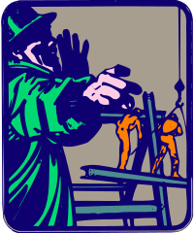
Constructor
Queue::Queue()
/*Post: The Queue is initialized to be empty.*/
{
count = 0;
rear = MAXQUEUE - 1;
front = 0;
}
Queue::Queue()
: count(0), rear(MAXQUEUE-1), front(0)
/*Post: The Queue is initialized to be empty.*/
{
// nothing needed here
}

Slide 15
empty()
bool Queue::empty() const
/*Post: Return true if the Queue is empty,
otherwise return false.*/
{
return count == 0;
}

Slide 16
append()
// Post: item is added to the rear of the Queue.
// If the Queue is full return an Error_code of
// overflow and leave the Queue unchanged.
ErrorCode Queue::append(const QueueEntry &item)
{
if (count >= MAXQUEUE)
return overflow;
count++;
rear =
((rear + 1) == maxqueue) ? 0 : (rear + 1);
entry[rear] = item;
return success;
}

Slide 17
serve()
// Post: The front of the Queue is removed.
// If the Queue is empty return an ErrorCode
// of underflow.
ErrorCode Queue::serve()
{
if (count <= 0)
return underflow;
count--;
front =
((front + 1) == MAXQUEUE) ? 0 : (front + 1);
return success;
}

Slide 18
retrieve()
front
rear
// Post: The front of the Queue retrieved to the
// output parameter item. If the Queue is empty
// return an ErrorCode of underflow
ErrorCode Queue::retrieve(QueueEntry &item) const
{
if (count <= 0)
return underflow;
item = entry[front];
return success;
}
myItem
front
QueueEntry myItem;
myQueue.retrieve(myItem);

Slide 19
Lets Practice
Reporting Stock Activity
Assume you had some stock activity and know you need to report your gain/loss on your tax form. How much is gain or loss?
P stands for purchased
S stands for sold
p p p s s p s p
200 300 200 100 150 400 400
40 45 48 50 52 48 50 45

Slide 20

Chapter 3 Closes

